Slide 1

TEAM 11
PROJECT PROPOSAL

Slide 2
목차
1
TEAM INFORMATION
2
PROGRAM DESCRIPTION
3
PROJECT MILESTONE
3
GitHub ADDRESS

Slide 3
Part 1
TEAM INFORMATION

Slide 4



Part 1
TEAM INFORMATION
TEAM 11
Park Jong Ho
2nd Grade
Computer Science
Libin Joseph
3rd Grade
Computer Science

Slide 5
Part 2
PROGRAM DESCRIPTION

Slide 6
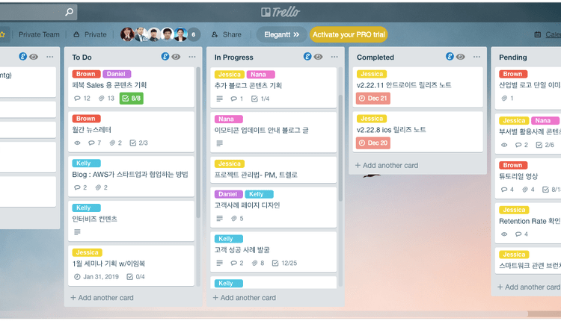
PROGRAM DESCRIPTION
Part 2
PROGRAM TOPIC
Lirello
Linux+Trello
Work Management PROGRAM runs like a Trello
Based on Text First, implement GUI if we can
PROGRAM interacts with Server Client

Slide 7

PROGRAM DESCRIPTION
Part 2
VISUAL CONCEPT – LOGIN PHASE
WELCOME TO LIRELLO!!
You can type your existing ID here
ID:
You can type your existing PW here
You can type ‘R’ or click to Register
PW:
You can type ‘L’ or click to Login
Register
Login

Slide 8
PROGRAM DESCRIPTION
Part 2
VISUAL CONCEPT – PROJECT MAKE PHASE
Print Existing page, you can choose existing project by type ‘e’ or click
EXISTING PROJECT
EXISTING PROJECT2
You can add project
By type ‘a’ or click
You can delete existing project by type ‘d’ or click
ADD
DELETE

Slide 9
PROGRAM DESCRIPTION
Part 2
VISUAL CONCEPT
TASK BLOCK
You can see Online person here
PROJECT NAME
SCHEDULE
TO DO
DOING
DONE
PARK
JOSEPH
SCHEDULE BLOCK
TO DO BLOCK
DOING BLOCK
DONE BLOCK
ANONYMOUS
You can add new task block by type ‘a’ or click
You can delete existing task block by type ‘d’ or click
ADD
DELETE

Slide 10
PROGRAM DESCRIPTION
Part 2
FUNCTIONALITIES
Register
You can type ID and PASSWORD
If you type existing ID, print ‘ID is duplicated’
Login
You can type ID and PASSWORD you typed in Register
Compare ID and PW with server data, if incorrect, print ‘ID or password is incorrect’
PROJECT MAKE
You can type ‘a’ to add a new project
You can type ‘d’ to delete a project

Slide 11
Part 3
PROJECT MILESTONE

Slide 12
Part 4
GitHub ADDRESS

Slide 13
TEAM 11`s PROPOSAL
Thank You

